Slide 1
ABC PHARMACEUTICAL SALES DATA ANALYSIS REPORT
A Comprehensive Sales, Product and Channel and Geospatial Data Analysis
Presented By
Okorigwe Clinton Egwologhene
16th December, 2024

Slide 2
Executive Summary
Project Goal:
To integrate diverse data sources and conduct detailed analyses to uncover sales patterns, optimize customer targeting, and enhance product distribution, enabling data-driven strategies to Improve marketing and operational efficiency.
Key Outcomes:
While statistically significant, the correlation is negligible, indicating that price has minimal influence on sales quantity. Other factors (e.g., product demand, quality, or marketing) likely play a more substantial role.
Sales performance differs meaningfully between Hospitals and Pharmacies, suggesting distinct purchasing behaviors or market dynamics for each channel.
Amount of sales in a geographical area is linked to the population density
Deliverables:
Dashboards, statistical reports, and recommendations

Slide 3
Problem Statement
Challenge: Difficulty integrating diverse data sources and performing granular analysis of sales performance and customer behavior.
Impact: Missed opportunities in targeting key customer segments and optimizing product distribution, leading to inefficiencies and reduced competitiveness.
Objective:
1. Identify sales trends over time, including peak periods and dips.
2. Examine customer demographics and purchasing patterns.
3. Assess product performance, highlighting best-sellers and underperforming items.
4. Analyze geospatial impacts on sales to pinpoint high and low-performing regions.
5. Compare sales performance across various customer channels.
6. Optimize sales strategies using data-driven insights.
7. Enhance product offerings based on performance and customer preferences..

Slide 4
Methodology
1. Data Preparation:
- Ingested data from a single table named *Pharm Data*.
- Cleaned and preprocessed data to handle missing values and inconsistencies.
- Used boxplot to analyse price distribution and Histogram to analyse sales distribution.
- Heatmaps to analyse correlation coefficients between different variables
- Modeled data into Fact and Dimension tables to establish relationships.
2. Analysis::
- Sales Trends: Used time-series analysis to identify peak sales periods and dips.
- Customer Behavior: Segmented customers based on demographics and purchasing patterns.
- Product Performance: Identified top-selling and underperforming products by class and average pricing.
- Geospatial Analysis: Assessed regional performance using geospatial libraries to map high and low-performing areas.
- Channel Analysis: Compared sales performance across channels (e.g., Hospital vs. Pharmacy).
3. Hypothesis Testing:
- Tested correlations between product prices and sales quantities.
- Analyzed differences in sales performance across channels using statistical methods (e.g., ANOVA).
- Evaluated urban vs. rural sales performance using geospatial and demographic factors.
4. Visualization and Reporting:
- Developed interactive dashboards in Tableau for visual insights.
- Created KPIs using DAX measures and incorporated them into dashboards.
- Summarized findings in a final presentation with actionable recommendations.
This methodology ensured a structured approach to uncovering insights and delivering data-driven solutions.

Slide 5
Data Overview
Source:
A single table named *Pharm Data*, sourced from the ABC Pharmaceutical sales database provided by 3signet.
Key Fields:
Sales data, customer demographics, product details, geospatial information (country, cities, coordinates), and sales channels (e.g., Hospitals, Pharmacies).
Data Volume:
Moderate dataset with 254082 rows and 19 columns covering sales across multiple cities and customer types.

Slide 6
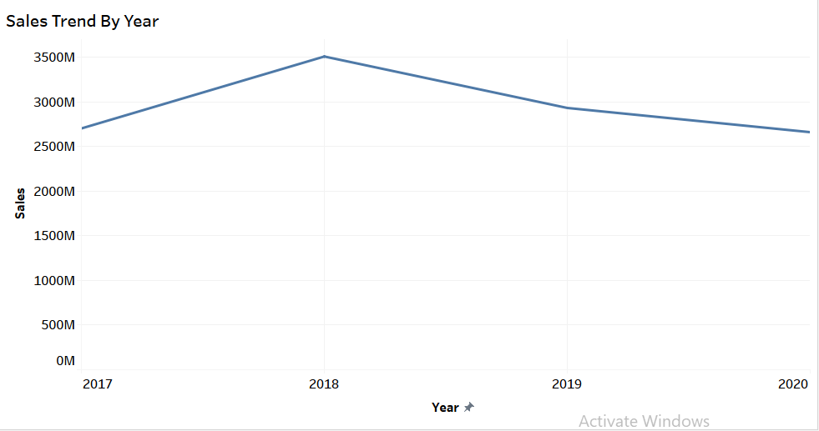
Findings
Sales Trends
Notes:
Line graph shows sales trends by year with the peak year being 2018 with total sales of 3,506,897,354 and lowest dip being 2020 with total sales of 2,659,672,412

Slide 7
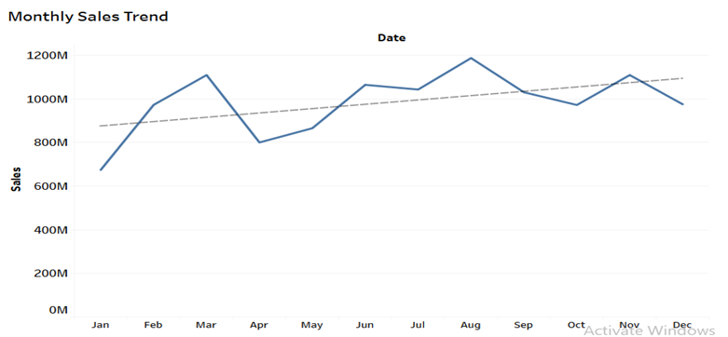
Sales Trend contd
Notes:
Line graph for the monthly sales trend shows an upward trend in sales for the months as shown by the trend line. The lowest dip is in the month of January with a total sale of 674,191,145 while the peak month is August with total sales of 1,186,627,360

Slide 8
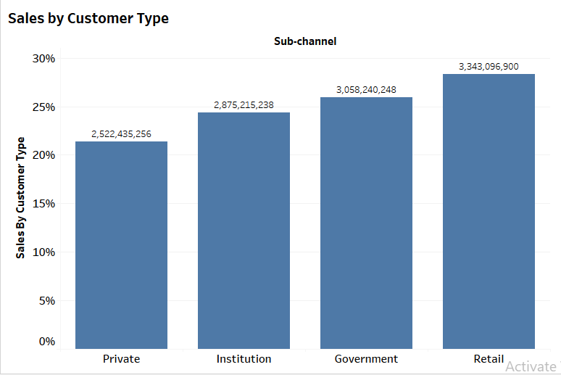
Customer Behaviour
Notes:
Analysis based on customer type or demographic shows retail stores are the highest buyers with 28 percent of the market share at 3,343,096,900 with private consumers being the lowest in market share at 21 percent at 2,522,435,256 , institutions and the government are at 24 percent at 2,875,215,238 and 26 percent at 3,058,240,248 respectively

Slide 9
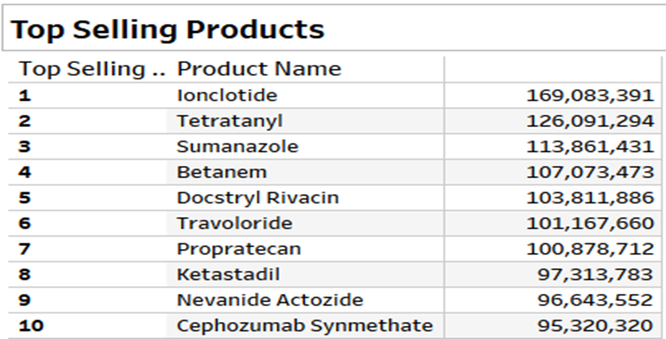
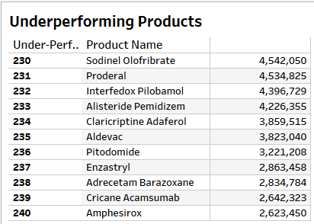
Product Performance
Notes:
Two tables showing a list of the 10 best performing products and their total sales vs the 10 most underperforming products

Slide 10
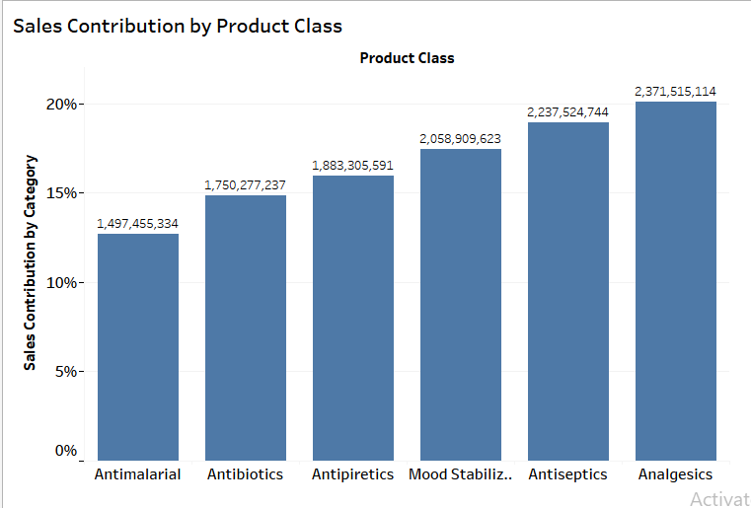
Product Performance contd.
Notes:
Bar chart shows sales contribution based on product class or category. Analgesics have the highest share of the market at 20 percent and total sales of 2,371,515,114 . Antimalarials have the lowest share of the market at 13 percent and total sales of 1,497,455,334

Slide 11
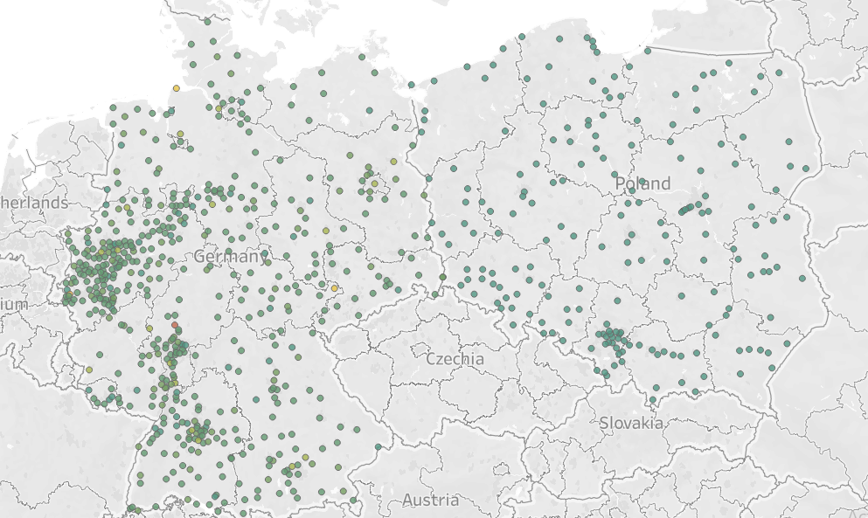
Geospatial Impact
Notes:
Geospatial Analysis shows sales skewed towards the cities in the country of germany as we can see… Germany has more points than Poland especially towards the NorthWest part of the country.

Slide 12
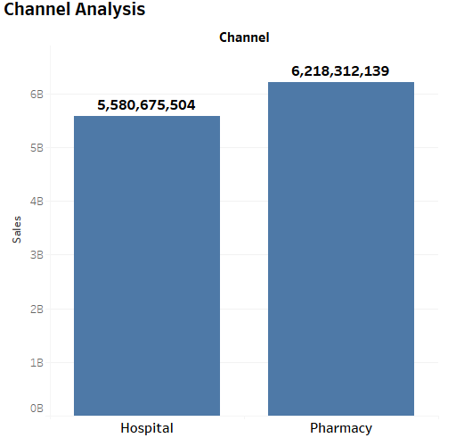
Channel Performance
Notes:
Channel analysis shows Pharmacy having a higher amount of sales than Hospital

Slide 13
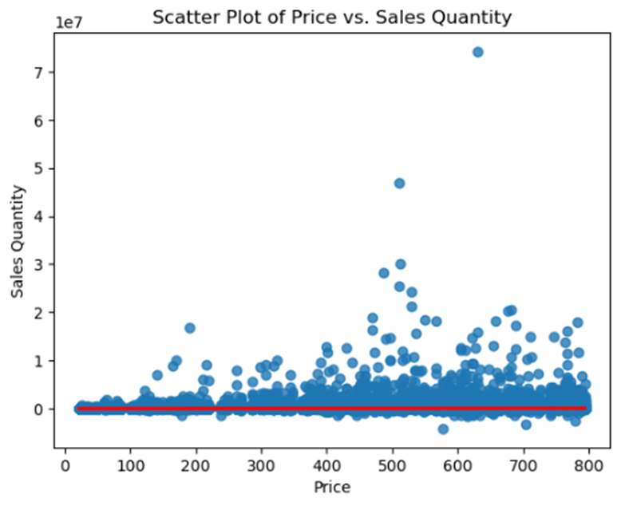
Hypothesis Testing
Hypotheses and Results
Hypothesis 1: Higher product prices correlate with lower sales quantities.
Notes:
This scatter plot visualizes the relationship between price and sales quantity. Here’s a quick analysis based on the plot:
Observations:
Trend: There seems to be no strong linear relationship between price and sales quantity. The data points are scattered without showing a clear pattern of increase or decrease.
Outliers: A few points have significantly high sales quantities, which could be outliers worth investigating.
Cluster: Most of the data points are clustered at lower sales quantities across the range of prices.
Regression Line: The red regression line appears almost flat, indicating a very weak correlation between price and sales quantity.
Possible Interpretations: No Strong Correlation: The flat regression line suggests price might not be a significant predictor of sales quantity, or the relationship could be non-linear.
Other Influences: Factors other than price (e.g., product demand, marketing, regional preferences) may have a greater impact on sales quantities.

Slide 14
Hypothesis 1: Correlation: 0.0706652122342445, P-value: 1.4141846626464404e-278
The results for hypothesis 1 "Higher Product prices correlate with lower sales quantities" indicates the following:
Correlation Coefficient (0.0707):A correlation of 0.0707 indicates a very weak positive relationship between price and sales quantity. This suggests that as product prices increase, sales quantities slightly tend to increase, but the relationship is almost negligible.
P-value (1.41e-278):The P-value is extremely small, far below any common significance threshold (e.g., 0.05), indicating that the observed correlation is statistically significant. However, "statistical significance" in this case means that the correlation is unlikely to have occurred due to random chance, not that the relationship is practically meaningful.

Slide 15
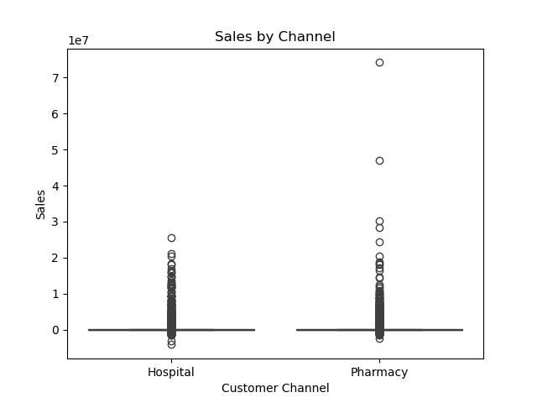
Hypothesis 2: Sales performance varies significantly between channels.
Notes:
This box plot compares sales performance across two customer channels: Hospitals and Pharmacies. Here's an analysis based on the visualization: Observations:
Median Sales: The medians for both Hospital and Pharmacy sales channels appear to be similar and relatively low compared to the range of sales values.
Outliers: Both channels have significant outliers with extremely high sales, suggesting a few products or transactions dominate sales figures in these channels.
Distribution: The sales data in both channels are heavily skewed, with most data points concentrated near the lower end of the sales scale.
Spread: The interquartile range (IQR) for both channels is narrow, indicating that most of the sales data falls within a small range, except for the outliers.
Possible Interpretations:
Similar Performance: Hospitals and Pharmacies show comparable sales distributions for most of their sales, suggesting no significant difference between these channels in typical sales values.
Dominant Outliers: The outliers might represent high-demand products, bulk purchases, or seasonal effects.
Skewed Sales: The concentration of data at the lower end might indicate a large number of low-value transactions in both channels.

Slide 16
Hypothesis 2: T-statistic: -2.077153182536199, P-value: 0.03778842554598785
The T-statistic and P-value provided relate to Hypothesis 2: "Sales performance varies significantly between different customer channels (Hospital vs. Pharmacy)." Here's the interpretation:
Analysis
T-Statistic: The value of -2.077 suggests that there is a measurable difference in the means of sales performance between the two customer channels. The negative sign simply indicates the direction of the difference (e.g., Hospitals might have slightly lower sales than Pharmacies or vice versa).
P-Value: A P-value of 0.0378 is less than the common significance level of 0.05. This indicates that the difference observed is statistically significant, and there is less than a 3.78% chance that this result occurred due to random variation.
Conclusion
Reject the Null Hypothesis: Based on the P-value, we reject the null hypothesis, which assumes no significant difference in sales performance between the two customer channels.
Support for Hypothesis 2: The results provide evidence that sales performance does vary significantly between Hospitals and Pharmacies.

Slide 17
Hypothesis 3: Sales are higher in urban areas than rural areas.
Due to inabiltiy to get the complete tabular data representing all the cities in this dataset especially for the cities in Poland, I have opted to use visual data from pre existing maps showing the population density distribution and comparing it with the geospatial visualizations generated on Tableau from the given data

Slide 18
Geo spatial Representation of Sales in Germany and Poland
Each point represents a city or a coordinate, and its total sales. We can see that there is a higher cluster of points at certain regions on the map and germany has a higher cluster f points than Poland indicating a higher frequency of sales in Germany and than Poland

Slide 19
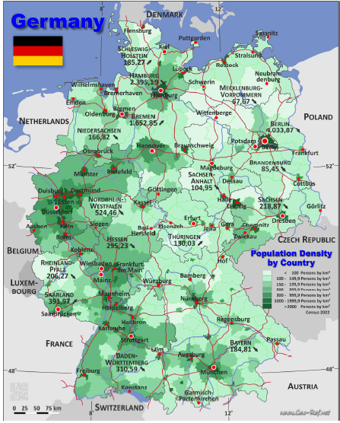
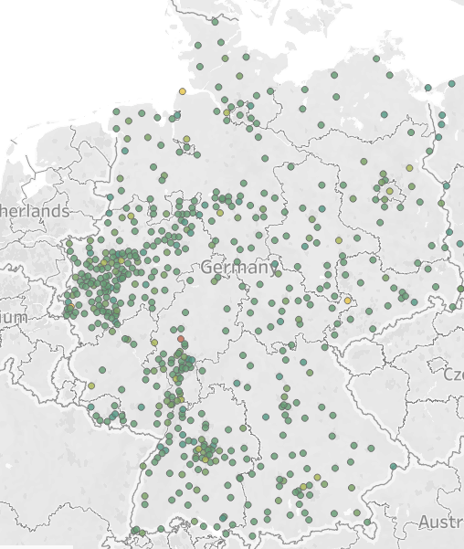
Comparison Between Maps to Test Hypothesis
Map of Germany’s Population Density
Geospatial Plot of Sales In Germany

Slide 20
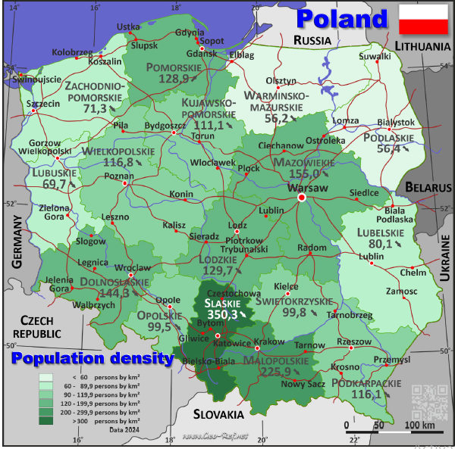
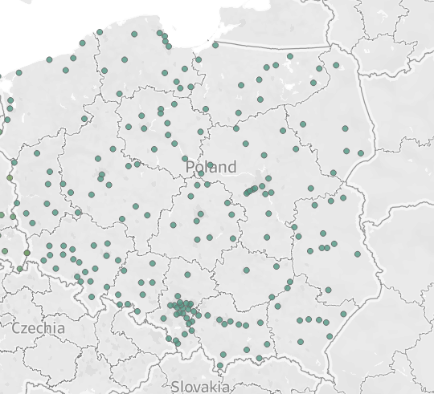
Map of Germany’s Population Density
Geospatial Plot of Sales In Germany
Notes:
From the above maps we can deduce that areas with higher point clusters or sales on the geospatial plot, corresponds with area of higher population density as we can see clearly especially in the north west of Germany with its higher population density than other parts of germany having higher clusters in the Geospatial plot for the same region. Areas with dark green on the maps have a population density of up to a 1000 persons per km square which qualifies such regions as urban areas and places with a lower shade of green, e.g Sulwaki area in Poland, have a lower points for Spatial Plot, although some rural areas have higher sales than urban areas, this phenomenon would require further research.

Slide 21
Recommendations
Hypothesis 1
Weak Price-Sales Relationship: A negligible positive correlation (0.07) suggests price changes have minimal impact on sales quantities.
Statistical vs. Practical Significance: While statistically significant, the relationship is not practically meaningful.
Strategic Focus:
Pricing: Optimize pricing for value-based or premium strategies.
Sales Drivers: Focus on product quality, marketing, and customer targeting.
Product Differentiation: Highlight unique features to reduce price sensitivity.
Next Steps: Analyze other factors (e.g., promotions, demographics) to better understand sales drivers.

Slide 22
Hypothesis 2
Significant Channel Difference: Sales performance varies significantly between Hospitals and Pharmacies (T = -2.08, P = 0.0378).
Strategic Insights:
Targeted Strategies: Tailor sales and marketing efforts based on channel performance.
Hospitals vs. Pharmacies: Investigate why one channel outperforms the other (e.g., pricing, demand, or distribution).
Resource Allocation: Optimize investments in the higher-performing channel.
Next Steps: Perform deeper analysis to identify factors driving channel-specific performance.

Slide 23
Hypothesis 3
Population density equals higher sales frequency in region:
Regions with popuation density of more than 1000 persons per square kilometer equate to urban centers will see a higher concentration of sales compared regions below 1000 persons per square kilometer which equates to rural areas.
Strategic Insights:
Targeted Strategies: Tailor sales and marketing efforts based on regional performance.
Urban vs Rural area: Investigate why one region outperforms the other (e.g., pricing, demand, distribution or remoteness(for rural areas).
Resource Allocation: Optimize investments in the higher-performing regions to bring in more profit.
Next Steps: Perform deeper analysis to identify factors driving region specific performance.

Slide 24
Conclusion
The analysis reveals key insights into ABC Pharmaceutical's sales performance:
Price and Sales: A weak positive correlation (0.07) indicates price has minimal impact on sales, suggesting other factors drive performance.
Channel Performance: Sales vary significantly between Hospitals and Pharmacies (T = -2.08, P = 0.0378), highlighting the need for channel-specific strategies.
Urban vs Rural: Urban area with higher population density outperform rural areas
Key Takeaways
Focus on channel optimization and targeted strategies.
Explore external factors and geospatial trends to enhance decision-making.
These findings provide a foundation for advanced analysis and actionable recommendations.

Slide 25
THANK YOU

